Slide 1
Tutorial 4:CSS
IT1152 / IT1552 / IT1652 / IT1852 / IT1952
Web Development

Slide 2
Explore the effect of CSS
Visit http://www.csszengarden.com/
Try out the different CSS to see how changes of CSS change the appearance of a web page.
Choose the first default CSS, use the Chrome inspector to modify the font family, colour and the font-size
Will you be able to change the font family to Verdana, font colour to purple and font-size to 2 times bigger than the normal size?

Slide 3
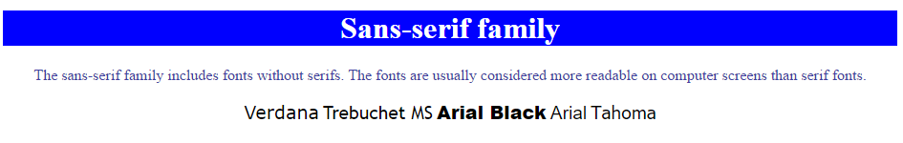
Experience Font &Text-Formatting
Go https://codepen.io/taysf/pen/mmmRpe
Add the CSS to have the web content displayed as below:
Text of document is centralized.
Background colour for heading 1 is blue.
Colour for the paragraph is #4040a1
Text for each of the font type is displayed as its font family. Size is 1.5 times the default size

Slide 4
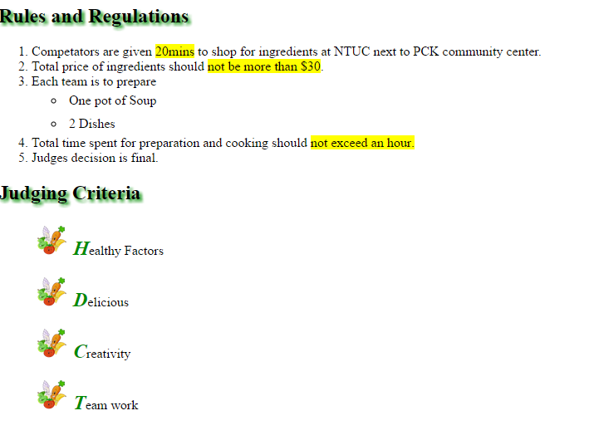
Formatting List
Set text shadow using color #008B00
Highlight the phrases in yellow.
Change the bullet point to image vegetable.png that downloaded and adjust the position of the image as shown
Set the first letter of the list item to be
bold
color to #008B00
50% more than the default size.

Slide 5
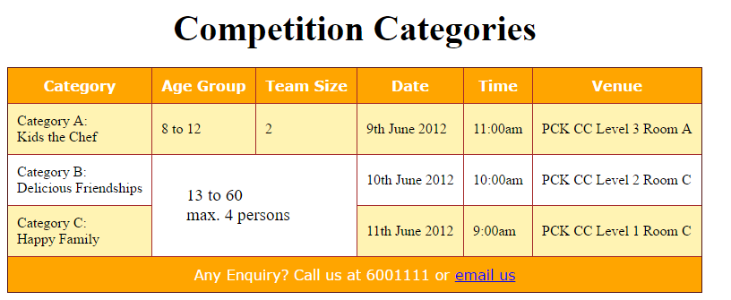
Formatting Table
Caption is bold, 20px away from table, font size 1.5 times of default
Set background color of the header and the last row to orange
Set font color of the header and last row to white
Make all the cells more spacious
Challenge
Set background even number table row to rgba(255,215,0,0.3)
Set cell with rowspan to have left padding of 2em and font size of 1.2 times of default size.
Collapse the border of the table and cells.
Set color of border to brown.

Slide 6
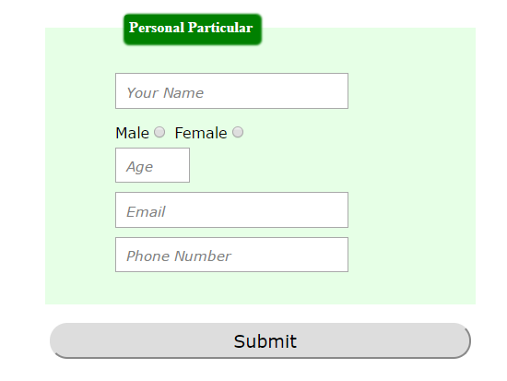
Formatting Form
Complete the CSS file (form.css) to style the form as shown

Slide 7
Who Win? Test it out….
Given the following style, test it out, observe the colour of text.
Which selector has the highest specificity?
<body>
<p>This is a paragraph</p>
<p class="pGrp">This is a paragraph</p>
<p>This is a paragraph</p>
<p>This is a paragraph</p>
<p id="specialP" class="pGrp">This is a paragraph</p>
<p>This is a paragraph</p>
<p class="pGrp">This is a paragraph</p>
<p class="pGrp">This is a paragraph</p>
<p class="pGrp">This is a <span>paragraph</span></p>
<p>This is a paragraph</p>
</body>
#specialP { color:red; }
span {color:green;}
p:nth-child(2n){color:orange;}
.pGrp { color:blue;}

